Slide 1
June 26, 2022
2.30 – 4.00pm
(BR, GMT-3)
Self-care: a Dynamic Approach
to Integral Health
Fernanda Cabral Schveitzer
Mariana Cabral Schveitzer
Fernanda Cabral Schveitzer and Mariana Cabral Schveitzer

Slide 2
SeLF-CARE: A dynamic approach to integral health
Coluna 02
SELF-CARE
A dynamic approach to integral health
SELF-CARE
A dynamic approach to integral health
SELF-CARE
A dynamic approach to integral health

Slide 3
IN YOUR OPINION
What is health?
What is care?

Slide 4
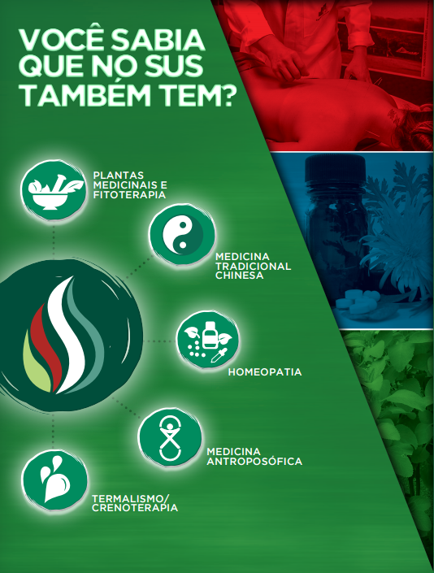
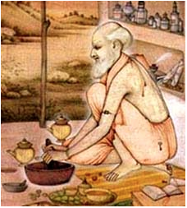
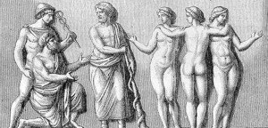
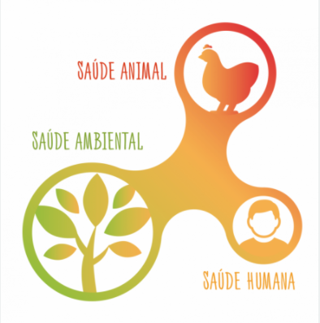
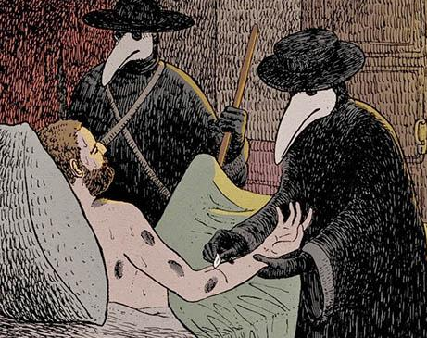
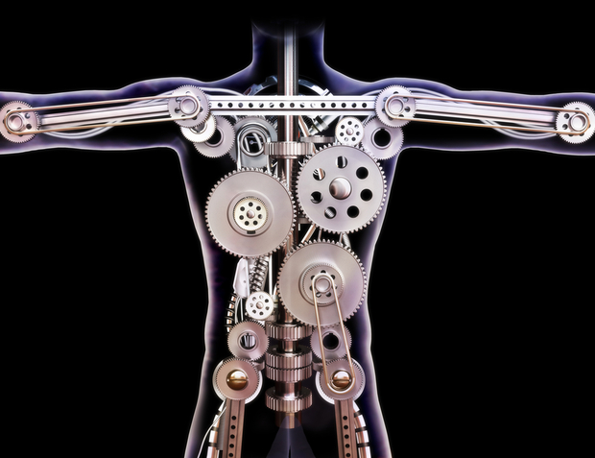
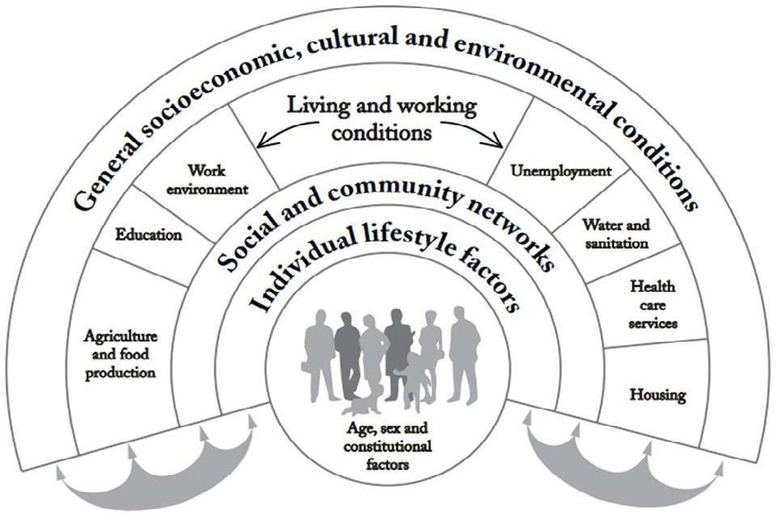
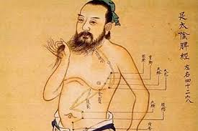
TIMELINE HEALTH-DISEASE-CARE
Miasmas
Religion
Magical thinking
Hippocrates
Renascence
Cartesian influence
Single-cause models
Infectious diseases
Multi-cause models
Epidemiological transition
Chronic diseases
Traditional Chinese medicine
Ayurvedic medicine
Antiquity
Middle Ages
Modern Age
Contemporary Age
476
1500
1945
Notes:
Colocar marcos de tempo no slide (anos/sec)

Slide 5
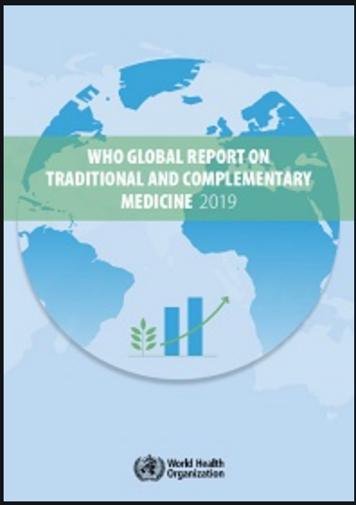
Integrative health
Year | National Policy of Integrative and Complementary Practices in Health - BRAZIL
2006​ | Homeopathy, Anthroposophic medicine, Traditional Chinese medicine, medicinal herbs and Phytotherapy, Thermalism – Crenotherapy
2017​ | Art therapy, Ayurveda, Biodanza, Circular Dance, Meditation, Music therapy, Naturopathy, Osteopathy, Chiropractic, Reflexology, Reiki, Shantala, Integrative Community Therapy, Yoga
2018​ | Apitherapy, Aromatherapy, Bioenergetics, Family Constellation, Chromotherapy, Geotherapy, Hypnotherapy, Laying on of hands, Ozone therapy, Flower therapy.
Acupunture
Ayurvedic medicine
Quiropraxia
Phytotherapy
Homeopathy
Naturopathy
Osteopathy
Traditional Chinese medicine
Unani Medicine

Slide 6
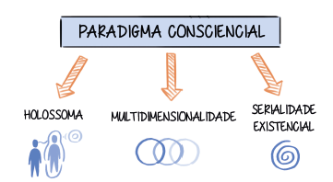
Growing Body of knowledge about Consciousness
CONSCIENTIAL PARADIGM
“Consciential health is the natural condition, dynamic state of equilibrium, or quality of the consciousness regarding its personal well-being, holosomatic homeostasis, and the harmonious relationship with holothosenes, constituting a resource for self-evolution”
CORDIOLI C. Conscientiology: a Brief Introduction to the Science of the Consciousness.
Editares: Foz do Iguaçu, PR, Brazil, 2019.
*Available in Portuguese, English and Spanish

Slide 7
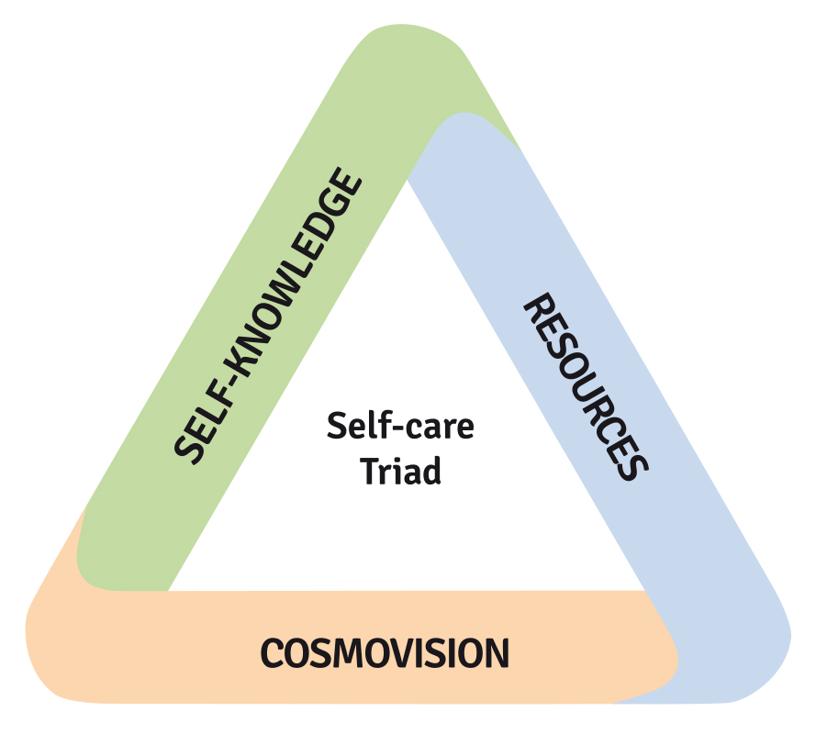
Self-care
Actions developed by a person for the benefit of their own life, health, and well-being , contributing to their development and aging.
SILVA et al., 2009 https://doi.org/10.1590/S0080-62342009000300028
Self-care is the combination of three factors that relate to and influence each other:
- Self-knowledge (understanding oneself and the personal health framework),
- Cosmovision as regards health (a critical view of the knowledge and health technologies offered)
- Good use of available health resources (techniques, practices, and professionals).

Slide 8
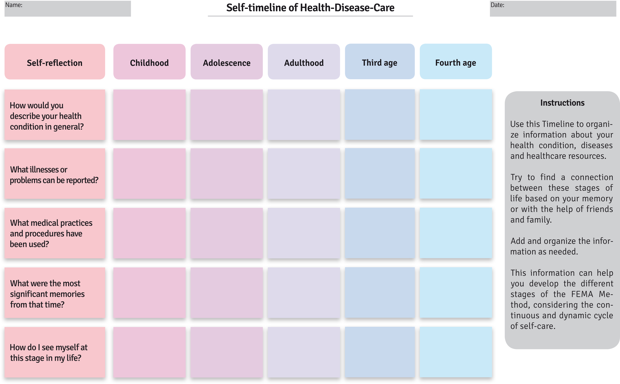
Título
TIMELINE HEALTH-DISEASE-CARE
Coluna 01
Coluna 02

Slide 9
FEMA Method
FEMA Method
Find
Embrace
Again
Move
FEMA Method

Slide 10
1. Find symptoms, discomforts, feelings, anxieties, diseases, illnesses and imbalances that demand attention; wants, interests and desires; health professionals who can help in this process; models and rationales that can guide care; help groups, virtual communities and people related to the same problem or interest;
2. Embrace, comprehend and understand such symptoms, changes, discomforts, diseases, insights and desires, without judgment or blame, in order to understand oneself and foster self-care. It includes universal ethics, gratitude, compassion and forgiveness;
3. Move, rearrange and recycle to produce the change of symptoms, difficulties, discomforts or illnesses. Change starts by choosing new goals and targets in relation to the five health perspectives: physical, energetic, emotional, mental and spiritual;
4. Again

Slide 11
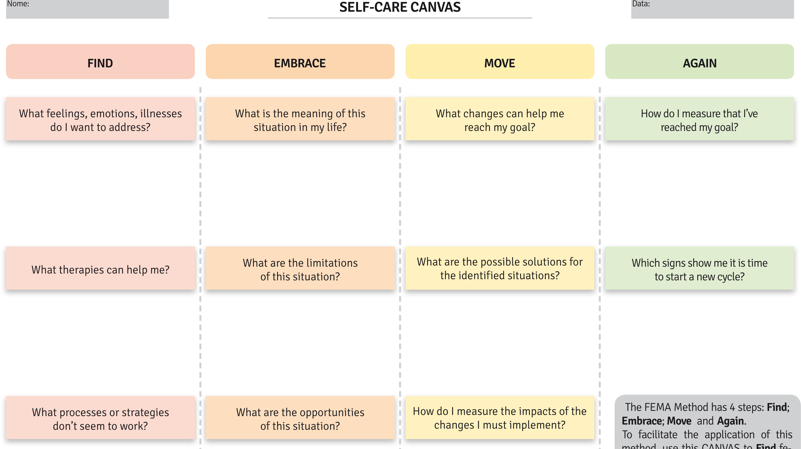
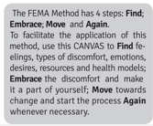

Slide 12
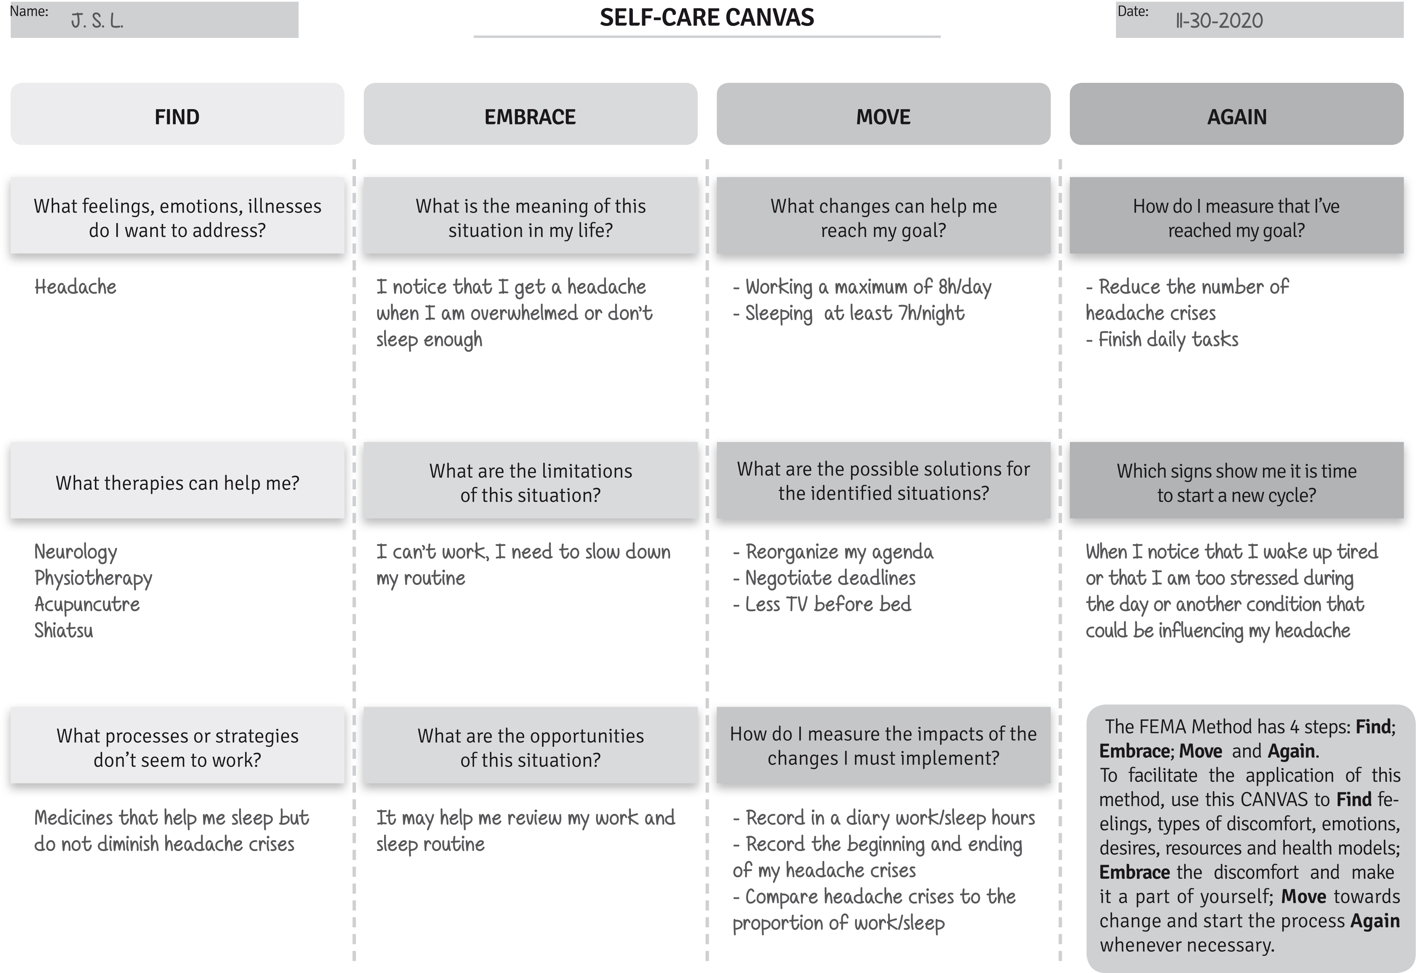

Slide 13
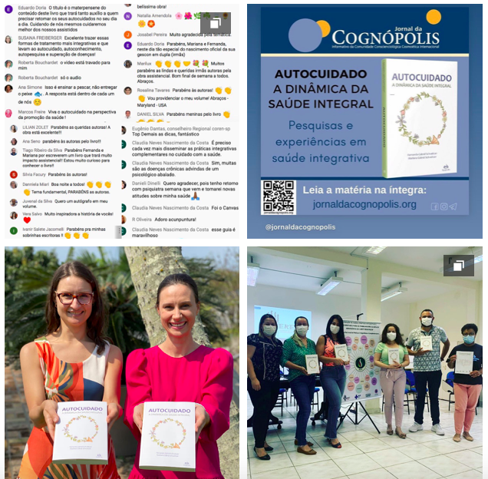
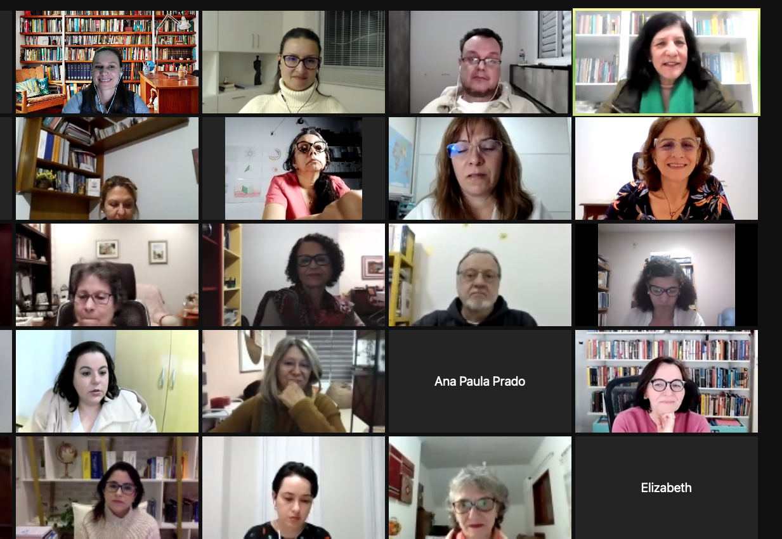
Notes:
Falar das apresentacoes, cursos, disciplinas…

Slide 14
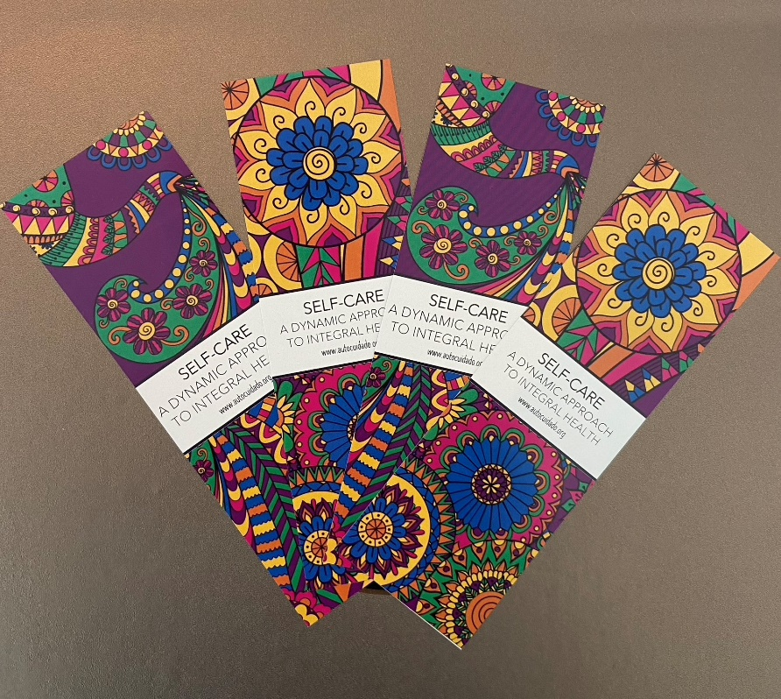
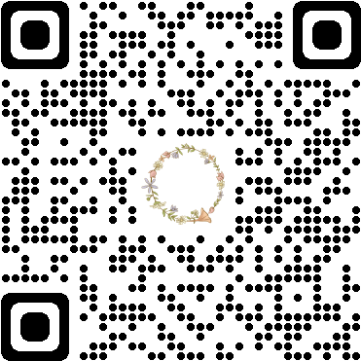
Thank you
www.autocuidado.org/english
Self-care: a Dynamic Approach to Integral Health
Fernanda Cabral Schveitzer and Mariana Cabral Schveitzer

