Slide 1
Jan 30, 2022
2.30 pm
Consciential Self-Relay:
What are we doing about it?
Pedro Fernandes

Slide 2
Principle of Disbelief
Don’t believe in anything you hear in this class,
experiment.
Have your own experiences.
Notes:
Hello everyone!

Slide 3
Why I’ve chosen this theme
Writing + Seriexology = Self-relay
Questions
Is it really possible to leave data for ourselves in next life?
How can we be so sure of that?
How is this going to happen?
Notes:
Hello everyone!

Slide 4
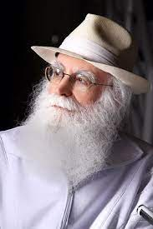
What is the scope of your awareness regarding your self-relays, linking this human life with the next?
Vieira, Conscientiogram, 2012, p. 195

Slide 5
Consciential self-relay
Consciential Self-Relay (CSR) is an advanced condition in which the consciousness evolves by securing one intraphysical existence to another, consecutively, like links in a chain, within their multiexistencial cycle.

Slide 6
Consciential self-relay
Practical Approach
(Personal Experiences)
7 Essential points
Theoretical Approach
(21 Strategies)

Slide 7
Personal experience in this subject
1. Personal experiences (1979-1985 / 5 to 11 years old)
Projective catalepsy
Semilucid projections
Clairaudience
Lucid projections (1986 / 12 y)
Notes:
Hello everyone!

Slide 8
Personal experience in this subject
Synthesis
Parapsyquic Phenomena and Memory
Intermissive period (preparation)
Helpers (assistance)
Notes:
Hello everyone!

Slide 9
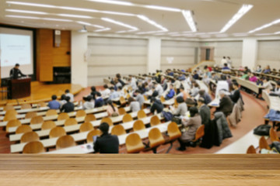
Personal experience in this subject
Volunteering (IIP, IIPC and CEAEC)
1st Brasilian Congress of Projectiology (1991)
Clairvoyance: “Grupecon” – helper (1992-1993)
Retrocognitive Projection (1996)
Notes:
Hello everyone!

Slide 10
Personal experience in this subject
Synthesis
Affinity with the group
Helpers identification
Retromemories (themselves)
Notes:
Hello everyone!

Slide 11
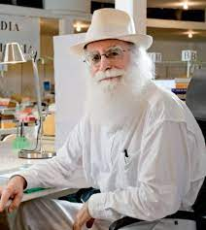
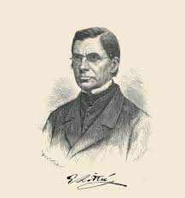
Personal experience in this subject
3. Foz do Iguaçu: relocation to new city
Waldo Vieira (2003/2004).
Holocycle – Jargons - 2004
Consecutive personality (itself) - 2009
Notes:
Hello everyone!

Slide 12
7 essential points
Synthesis
Parapsychism and memory
Intermissive period (preparation)
Extraphysical helpers (assistance)
Rediscovery of our group
Intraphysical helpers (tutoring, guidance, coaching)
Consecutive personality and retrocognition
Personal books
While self-relay is something rather difficult, this report stands to show that with plenty of help and intra / extraphysical effort we can recover information about our past lives and works that we wrote in the past.
Notes:
Hello everyone!

Slide 13
Self-relay

Slide 14
Consciential self-relay (CSR)
CSR is the lucid act by which an intraphysical consciousness passes on / transmits evolutionary and priority information to him/herself, notably by writing claritaskal books which could be recovered early next life

Slide 15
types
Self. It’s your responsibility (by yourself), not considering anything else.
Hetero. When you take back the work of someone who is now in the extraphysical dimension.
Group. When more people are engaged in the same Project.
Notes:
Hello everyone!

Slide 16
strategies
Extraconsciential
Intraconsciential
Interconsciential
Paraconsciential
Notes:
Hello everyone!

Slide 17
EXtraconsciential strategies
1. Write texts in diferents formats, sizes and conditions (published)
- Personal books,
- Group books (2 or more)
- Articles
- Verbets (Encyclopaedia Entries)
- Videos: cinematic capsules of time.
The more diversified the investment, the greater the chances of success
Notes:
Hello everyone!

Slide 18
EXTRACONSCIENTIAL strategies
Translation: help, encourage, or even sponsor the translation of personal texts into other languages
Poliglotism: give classes in other languages and make them available on the internet
Notes:
Hello everyone!

Slide 19
EXTRACONSCIENCTIAL strategies
Themes: write on themes you have a lot of affinity with (It will call your attention in your next life)
Style: find your own writing style.
Autobiography: writing a book that is autobiographical, so you can leave a synthesis of your life and yourself, all that was the most relevant and you would like to recover in your next life
Notes:
Hello everyone!

Slide 20
EXTRACONSCIENCTIAL strategies
Casuistry: remember to include personal didatic hooks in the class you record, on tertulias you conduct, and the texts you write so these hooks can trigger your memory in your future life
Temperament: spontaneously register your “ways” – how you express yourself during your recorded classes and tertulias
Specialty. Deepen your research and writings under a specific specialty with the goal of not just leaving written texts, but also fixating your own memories with the specific subject-matter.
Notes:
Hello everyone!

Slide 21
INTRAconsciential STRATEGIES
Future retrocognition: technique to prepare a priority memory to recover in next life. Choose a specific place where you generally go, or a task that you do regularly and notice all the minimal details, the surroundings, behaviour and energies so you can memorize – with the objective of preparing these mnemonic triggers in your next life.
Detailed self-research: having and honest interest in self-knowledge and connecting the dots of our self-manifestation to understand our personal modus operandi and with this mentally fixate your predominant attributes (megastrongtrait; retro-password; matherthosene and others).
Notes:
Hello everyone!

Slide 22
INTRAconsciential STRATEGIES
Self-mnemonic saturation: having the habit of reviewing your recorded classes, registering the details of your personal manifestation (holosomatics, arguments, facies, themes; clothes, and others details) is also rather important.
Pararapsychic memories: to value, record, and reflect on your parapsychic memories prepares your brain and parabrain for similar situation in your next life.
Notes:
Hello everyone!

Slide 23
INTERconsciential STRATEGIES
Heterolocation: when you try to seriexologically locate people close to you enhances the memory and the chance to recognize the person next life. Besides, it generates the habit of doing it.
Evolutionary duo: Deepening the seriexological intersection with your partner in the evolutionary duo will impregnate your memory with this information.
Notes:
Hello everyone!

Slide 24
INTERconsciential STRATEGIES
Helper consciex: Count on the support of helper consciexes. For this we need to improve our parapsychism and assistantial merit.
Helper conscin: Count on the support of helper conscins – with a more advanced parapsychism. Again, this depends on our merit and performance.
Notes:
Hello everyone!

Slide 25
PARAconsciential
Retrocognitive techniques: Trying out retrocognitive techniques often creates the habit of accessing the holomemory and gets us used to knowing how to deal with old memories, from past lives
Lucid projections: In the same way, being used to projective experiences allows us to go through the same in future lives.
Intermissive course: Accessing intermissive memories is the most effective form of self-relay because we go back to the source of our proexis.
Evolutiologist interview: Interview the group's evolutionary leader in order to increase the overall vision and know about the priority to be done.
Notes:
Hello everyone!

Slide 26
CONCLUSIONS
Writing a book is the most precious technique (golden rule)
Self-relay depends on several factors besides writing a book
All the conscientiological principles and techniques are already helping our self-relay, so let’s qualify it further
Today we are much more likely to perform it successfully, but it still demands a lot of effort and lucidity
We can try to link this current life with our past ones
Notes:
Hello everyone!

Slide 27
Notes:
Hello everyone!

