Slide 1




April 24, 2022
2.30 – 4.00pm
Retrocognitive Self-research and Writing
Roberto Leimig

Slide 2
Benefits of Retrocognition
Self-knowledge
Checking one´s recycling
Avoiding repetition of common mistakes
Finding members of one´s groupkarma in previous lives
Finding out about weak and strongtraits
Becoming aware of the foundations of self-evolution
2

Slide 3


Which are the benefits?

Slide 4

Recyclability: evolutionary challenges
Change of companions
Change of culture
Change of address
Change of profession
Change of personal materthosene
Change of evolutionary level
Change of the megafocus of our research

Slide 5
Affinity levels
Specific personality?
Team?
Key-personality?
Group?
Holothosene?
Beginning: recognition of
time and places

Slide 6

Retro-personality
Consecutive
Personality

Slide 7
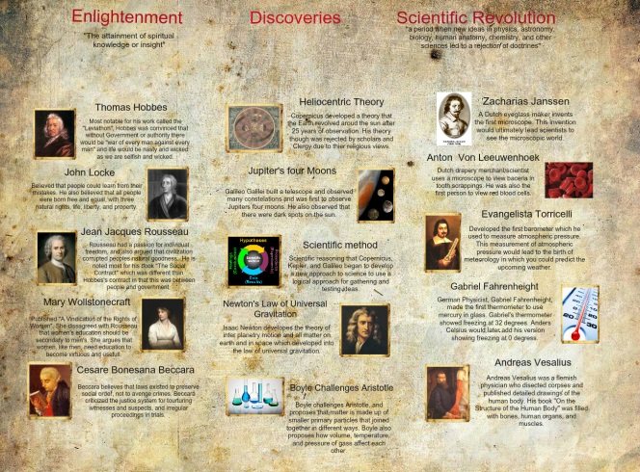
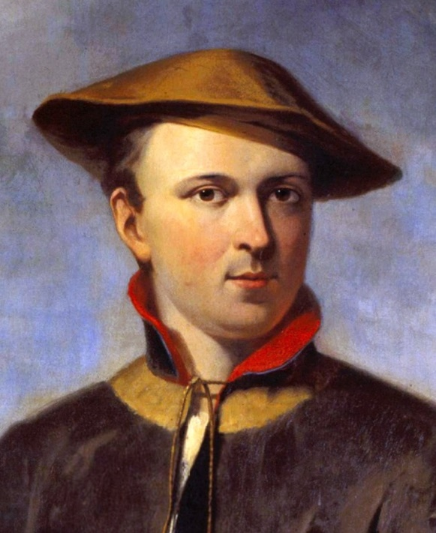
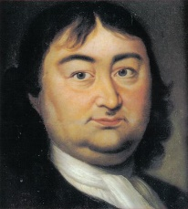
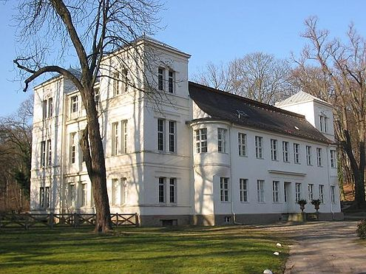
Specific Personality
Seriexological Identification
Group
Key Personality
Location and period

Slide 8
Which retropersonality should we prioritize in our self-research?
The oldest or the most recent?
The most productive or least productive?
The most well-known or the least known?
The most positive or the most negative?
The most family-bound or least bound?
The one that had a natural desoma, or one with an induced desoma?

Slide 9
Multiexistential self-conscientization
Axis of manifestation?
Temperament?
Paragenetics (retrocode)?
Genetics?
Zeitgeist?
Which are the major influences?

Slide 10



























Bellicism / Militarism
With which groups do you maintain a healthy and unhealthy connections?
Science / Research
Religion / Mysticism
Myself
Do you stay around them or not?
Sex / Seduction
Politics/Power
Zeitgeist/ Socin

Slide 11
Levels of Paraperceptions
Episodes
Flashes
Recurrent parapsychic signal
Recurrent synchronicity
Extraphysical team
Parapsychic research

Slide 12
Memory and Holomemory
Memory:
Store and retrieve information
Related to the physical body
Short or long-term memory
Holomemory
Integral memory of the consciousness
Paragenetics keep all the intra and extraphysical memories along the seriexis.
12

Slide 13
Retrocognitive Memory:
1. Affective memory
2. Assimilative memory
3. Extraphysical memory
4. Impressive memory
5. Parapsychic memory
6. Reflective memory
7. Sensory memory
Notes:
13

Slide 14
How to access retrocognitions?
Souvenirs - images, scenes
Concepts, ideas
Places, landscapes, urban/natural/rural
Holothosenes
Experiences (revivals)

Slide 15

Ectopia
Wrong approach
Object
Evidences
Results and Conclusions
Tie the ends
Methodology
Past
Present

Slide 16
Avoidances: items to avoid
Absolute certainty
Dogmatism
Mysticism
Personalism
Forced synchronicities
Undervaluing facts and parafacts
Biases

Slide 17
Prophylaxis of biases
Reflection
Self-criticism
Ponderation
Reduction of anxiety
Association between different occurring phenomena
Gather diverse evidences

Slide 18
Indicators to identify Retropersonalities
Paraphenomena
  Retrocognition
  Synchronicities
  Conscious projections and recurrent dreams
  Energetic signals
  Clairvoyance and clairaudience
Notes:
18

Slide 19
Indicators to identify Retropersonalities
Coincidences
  Profession
  Family
  Social groups
  Place one lives, trips to ancient homeland
  Skills
Notes:
19

Slide 20
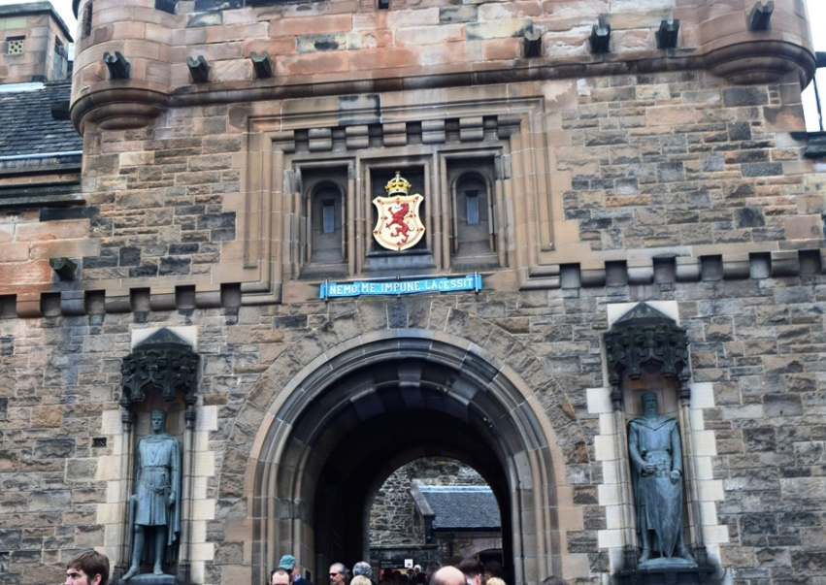
Positive indicators of Retromorphothosene
Flashes and remembrances
Euphoria
Reencounters
Memory extrapolations
Bioenergetic sphere
Notes:
20

Slide 21
 | Retrocognitive Phases | Characteristics | Examples
1st | Phase of Identification | First casual and unsuspected contacts, direct or indirect. | Images
2nd | Phase of Connection | Deeper identification of affinity with biographies. | Ideas
3rd | Phase of Suspicion | Recurrence of the contact, finding of biographical and parapsychic similarities and acquisitions. | Documentaries
4th | Phase of Distant Hypotheses | Reasonable accumulation of evidence and synchronicities interconnecting object (retrolife) and subject (researcher). Book / Travel. | Finding books
5th | Phase of Reluctance | Reactions contrary to the accumulation of evidence of being the very object of research, in opposition to synchronicities. | The case of a souvenir
6th | Phase of Approximate Hypotheses | Admit the possibility of being the biography studied, or of similar character, friend, related person, very rarefriendship, helper. | Voyage
7th | Phase of Recognition | Evidences of temperament, intellectual and ethological similarity, flashes and mnemonic episodes accumulated. | Confrontations

Slide 22
Hypothesis
01. Hypothesis of having been a colleague
02. Hypothesis of having been a former relative
03. Hypothesis of having been a former assisted
04. Hypothesis of having been a former assistant
05. Hypothesis of former helpers
06. Hypothesis of the protected
07. Hypothesis of self-knowledge
08. No hypothesis
09. Reverse hypothesis
10. Ultimate hypothesis: Hypothesis of Consecutive Personality

Slide 23
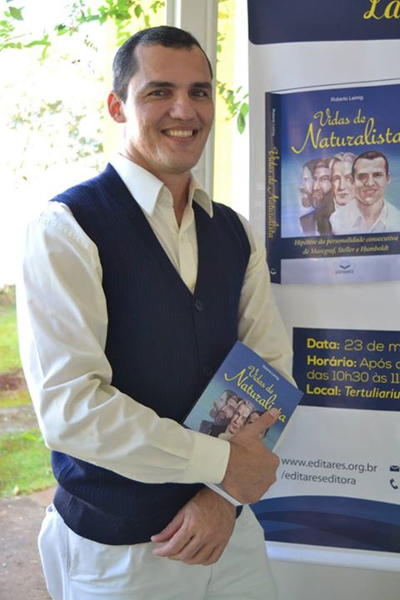

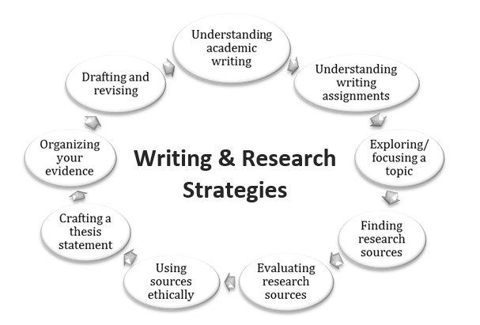

Slide 24


Thank you All

